Slide 1
San Francisco Crime Analysis & Visualization in R
Presented by:
Avish Jadwani

Slide 2

Introduction and Objective
Controlling crimes and taking steps to reduce them is an essential task
SFPD has made the crime records available online and open to public
Anyone can take the crime statistics there and make analysis
We selected 2003 to 2015 to do our analysis
Calculating statistics such as mean, variance, crime rate, count of crime and conduct hypothesis testing, goodness of fit, histograms and scatter plots
Determine areas and types of crime occurring frequently and in a particular district to give advices to police department and to control crimes, taking steps to reduce crimes

Slide 3
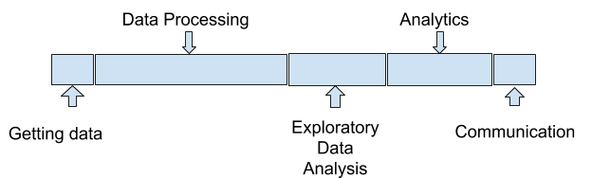
Project Flow

Slide 4
Data
Data fields
Dates - timestamp of the crime incident
Category - category of the crime incident
Descript - detailed description of the crime incident
DayOfWeek - the day of the week
PdDistrict - name of the Police Department District
Resolution - how the crime incident was resolved
Address - the approximate street address of the crime incident
X - Longitude
Y - Latitude
Data cleaning
The dataset contained 878050 points(obtained from kaggle) detailed from the year 2003 to 2015
Due to large size of dataset we selected the year 2014 for our analysis
Further the dataset was divided into date,month & time for ease of analysis

Slide 5
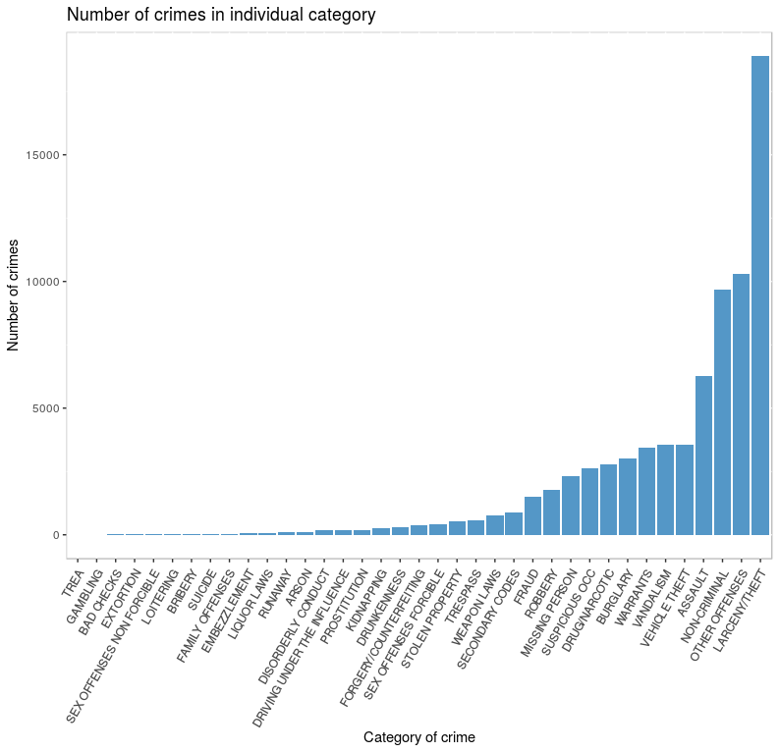
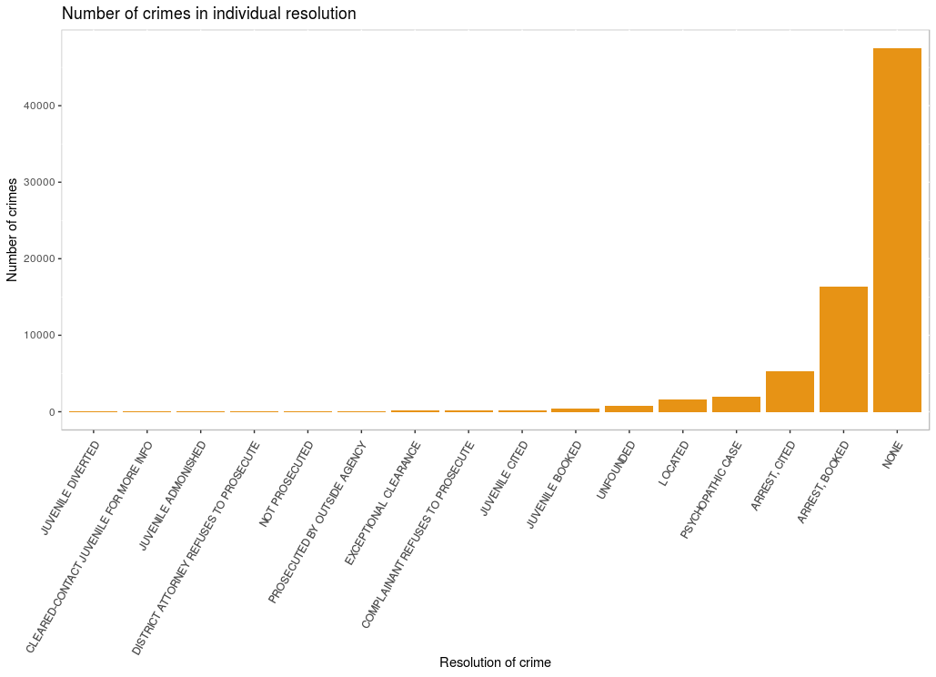
Is San Franciso Safe ?Are Crime Cases being Resolved ?
Number of crimes vs Crime Category
Number of Crimes vs Resolution of Crime
Larceny/Theft, Other Offences, Assault & Non Criminal appear to be major crimes is San Francisco
Most reported crimes were not be resolved. Of all the cases solved, most had arrest booked as a resolution status.

Slide 6
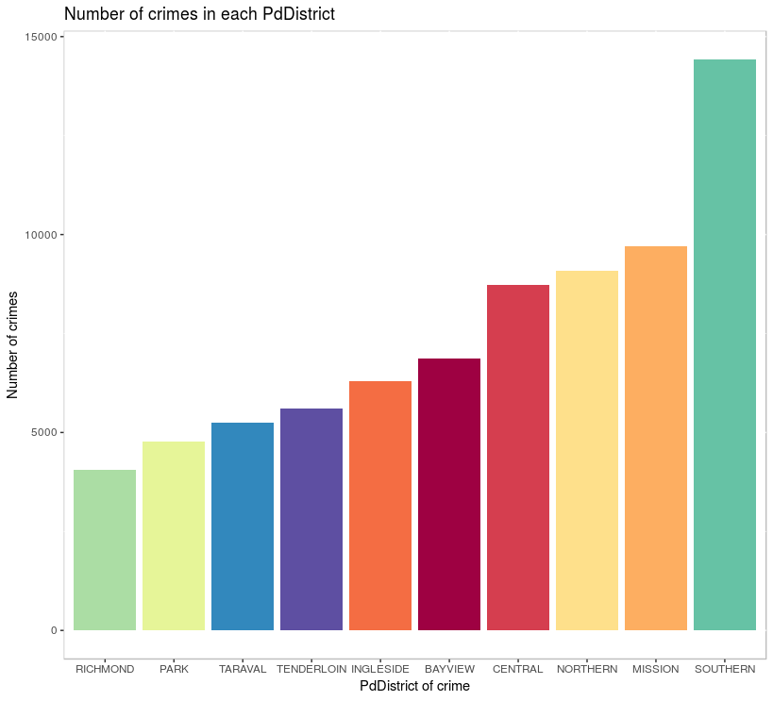
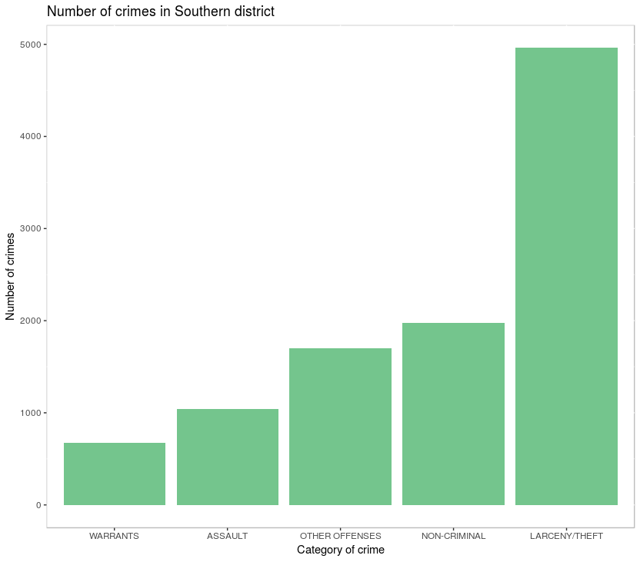
Unsafe Neighbourhood in San Francisco
Number of Crimes in Each District
Number of Crimes in Southern District
Most crimes committed in southern district and least in Richmond In the Southern district, Larceny/Theft, Non Criminal were
major crimes.

Slide 7
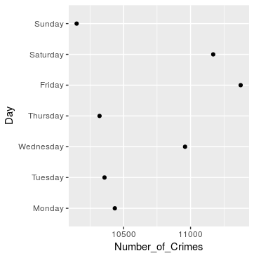
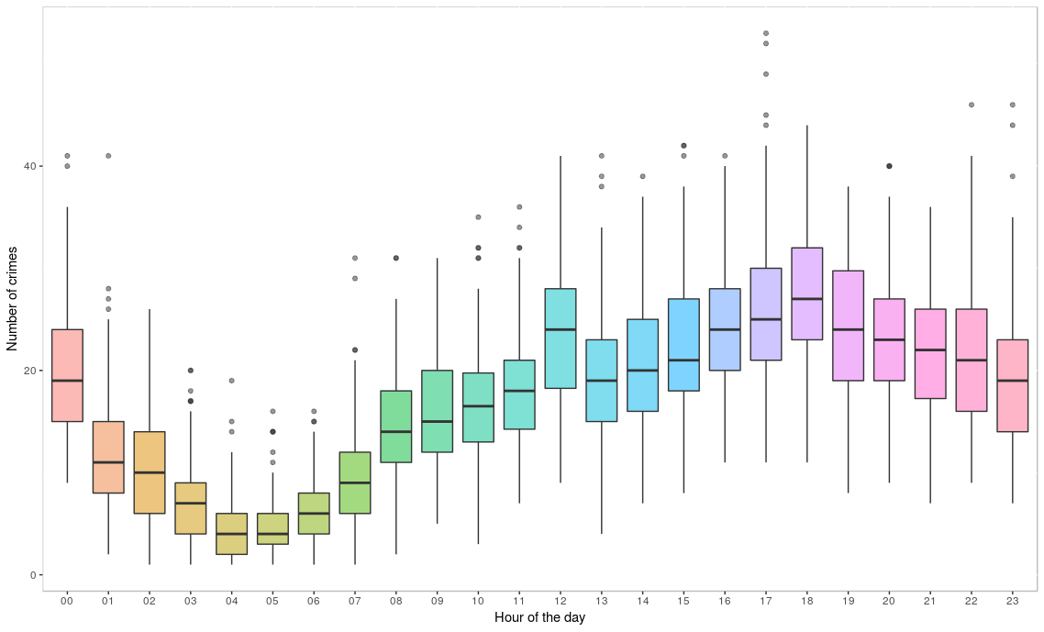
Which day & hour had most crimes cases?
Friday and saturday had most crime cases and lowest on Sunday
There is a dip in crime in the midnight. The crime rate increases during the day with most crimes in the evening between 5 to 7 pm

Slide 8
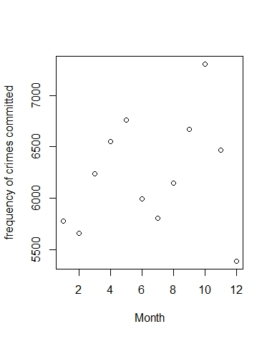
Crimes frequency by month
There were highest amount of crimes committed during the months October and November and was least in December, so holiday season needs more policing.

Slide 9
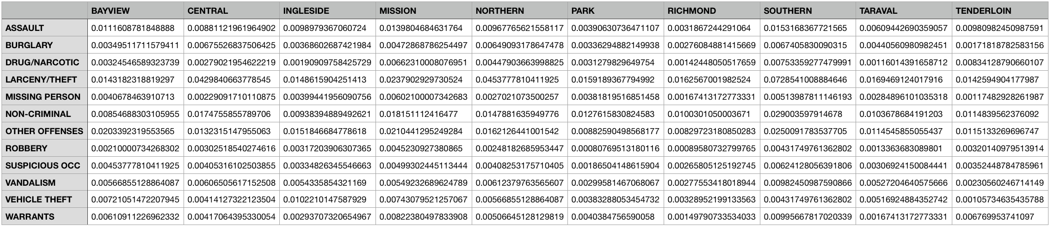
Joint Probability Distribution
What is the probability that incident was drug/narcotic related and occured in the Tenderloin district ?

Slide 10
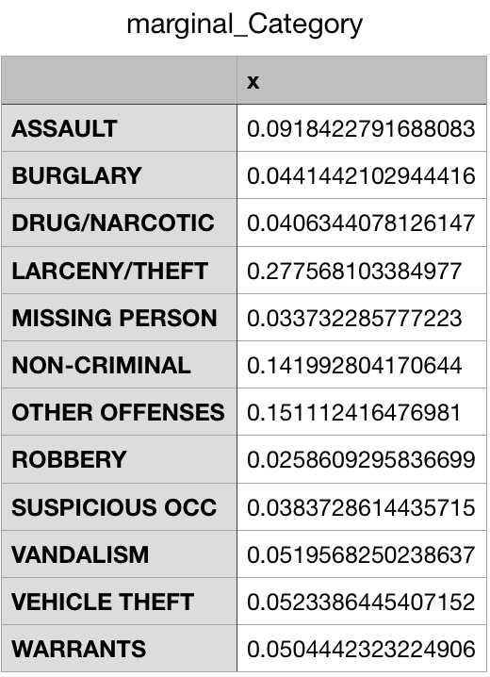
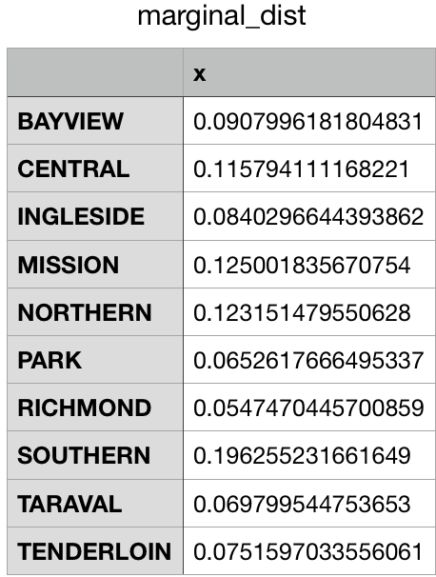
Marginal Probability
Probabiltiy of occurence of each crime category Probabiltiy of Occurence of Crime in each District

Slide 11
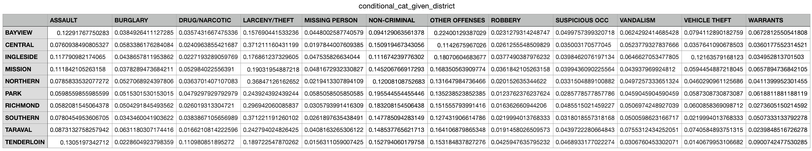
Conditional Probability of category given district
Given that a crime occured in richmond district what is the probability that the crime was drug/narcotic related ?

Slide 12
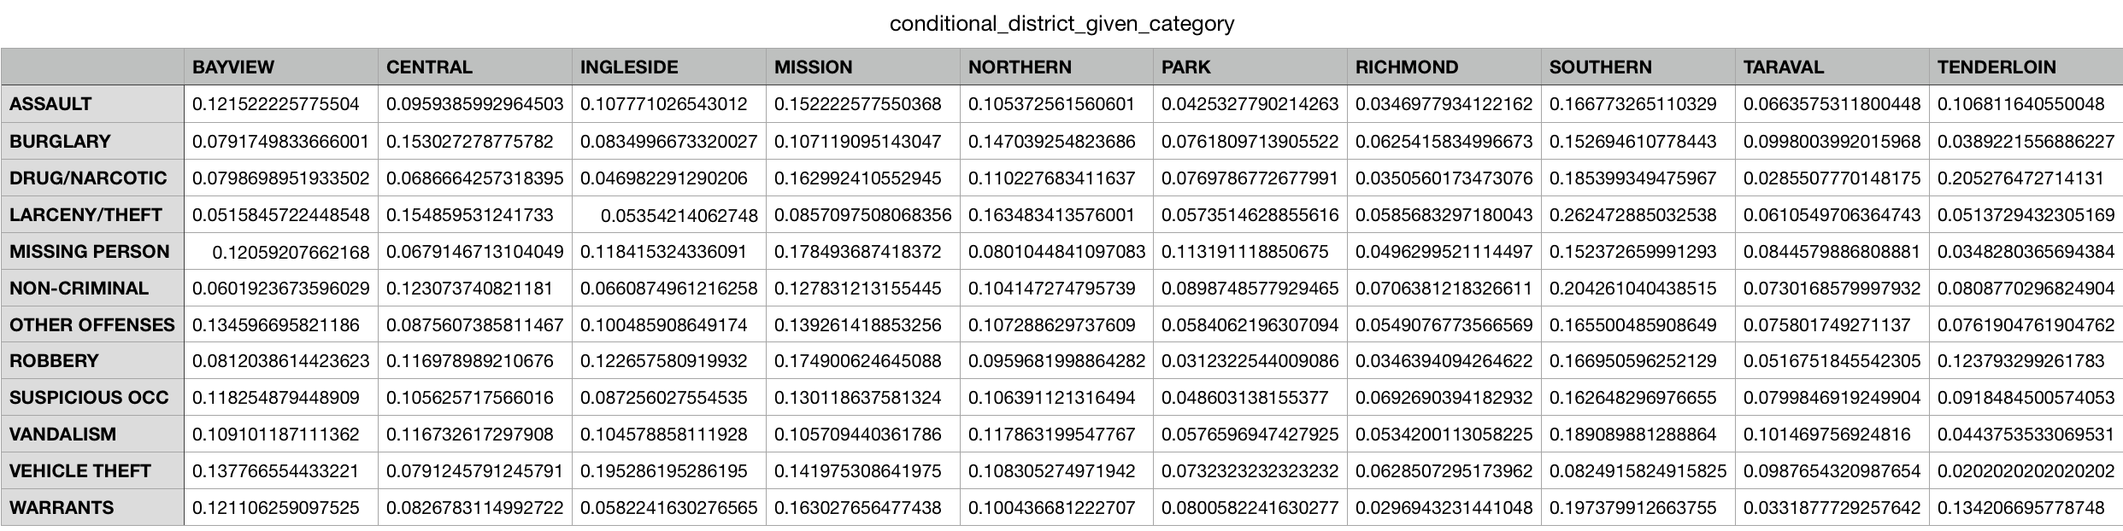
Conditional Probability of District given Category
Given that a vehicle theft incident has been reported, what is the probability that the crime occured in Mission region?

Slide 13
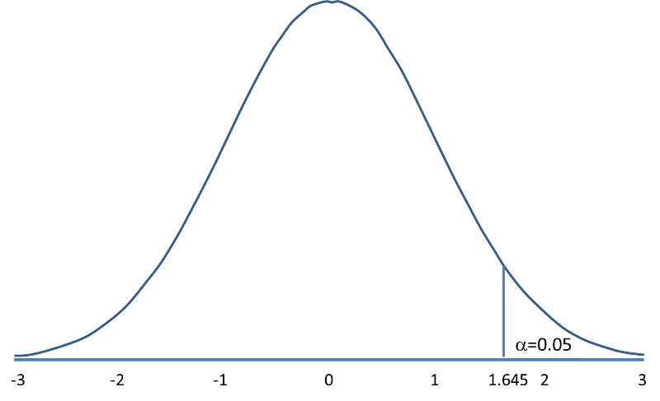
Z-Test Hypothesis Testing
σ = 1.684 crimes/hour
μ = 17.116 crimes/hour
Z= -129.6205
H0= Average crime rate of Richmond region < Average Crime Rate of San Francisco
H1= Average Crime rate of Richmond region > Average Crime Rate of San Francisco

Slide 14
Thank You
Questions ?

